Slide 1
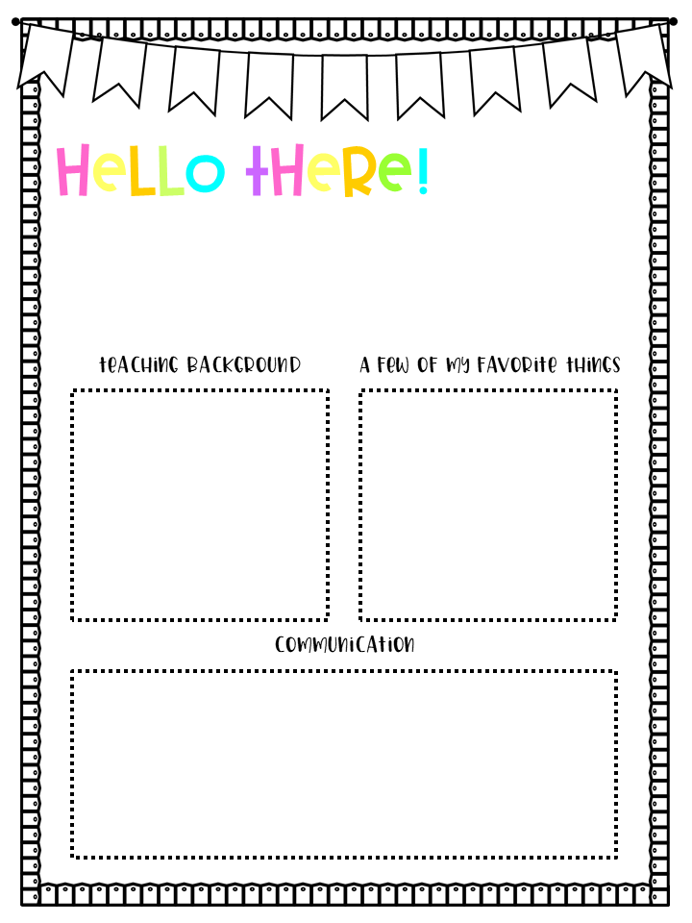
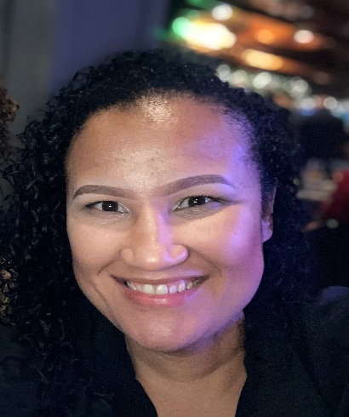
My name is Mrs. Bronwynne Stewart
and I am ecstatic to be your child’s PreK teacher for this 2023-2024 school year here at John Robert Lewis Early Childhood Center! I was born in Cape Town, South Africa and immigrated to the United States in 2004. I have been married for 18 years and have a 4-year-old daughter.
I have been in the Orange Public School’s district for 11 years as a PreK paraprofessional and now my second year as a Preschool Disabilities teacher at John Robert Lewis Early Childhood Center. I am a graduate of Kean University where I majored in Early Childhood Education, obtained a concentration in Fine Arts, and earned an endorsement in Preschool through Grade 3 and Special Education. My education and experiences have helped me to build a foundation in becoming the best educator that I can be for your child.
Colors: pink
Foods: Rice and beans, seafood paella, Mahi Mahi, red snapper and tres leches cake
Drinks: lemon and lime seltzer water, green tea, and ginger tea
Favorite children's book: The Giving Tree
Hobbies: crafting, cooking, singing, painting and decorating
Restaurant: Boqueria NYC
Stores: Target, T.J.Maxx, Marshalls
Email: StewarBr@orange.k12.nj.us
Phone Number: (973) 677 4000 ext. 51700
You can also communicate with me by sending me a message via ClassDojo.
If you have any questions, concerns, or want to inform me of anything you would like me to know about your child, please do not hesitate to contact me. Thank you so much and I am really looking forward to getting to know you and your child.

